Slide 1
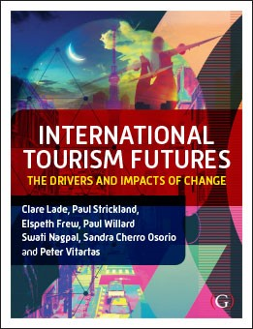
Chapter 13: The Demise of Tourism

Slide 2
Chapter Outline
Introduction
Reliance of natural resources in the travel,
Plausible futures
Hospitality and event sectors;
Global population growth;
Food security;
The impact of war on tourism; and
The moral considerations associated with certain tourist experiences. Pandemics including COVID-19
Summary
Case study and additional resources

Slide 3
Introduction
This session investigates the possibility that the tourism industry, as we currently know it, will significantly change and perhaps will not exist in the future.
Some topics will be discussed in the realm of plausible futures, meaning that they may not happen, however it’s a possibility and in the event it does occur, the tourism industry should be prepared.
Notes:
.

Slide 4
Plausible Futures
Plausible futures is the possibility of something occurring but it may not happen (Walton, 2008)
Plurality of futures which is not necessarily a predicted trend, making it an ideal structure for discussing global events and concepts of the future (Strickland, 2012; Yeoman, 2012)
Notes:
Plausible futures fits within the realm of future studies that is considered an under-researched area in tourism (Frost et al., 2014). Authors such as Amelung and Viner (2006), Walton (2008), Bergman et al. (2010), Yeoman (2013) and Postma et al. (2017) have all undertaken research in this area.

Slide 5
Natural Resources in Tourism, Hospitality and Events Sectors
Nature-based tourism is ‘physical recreation characteristics, level of development, management, intensity of use and anticipated behavioural classes’ (Priskin, 2001: 640).
From this research, a further four categories regarding natural resources have been identified:
attraction diversity;
accessibility;
supporting infrastructure and
the level of environmental degradation (Priskin, 2001: 642).
Notes:
When evaluating natural resources required for the tourism, hospitality and events sectors, studies have been heavily reliant on demand and supply factors in terms of visitors, commercial businesses, governments and non-government entities (Clawson and Knetsch, 1963).

Slide 6
Natural Resources in Tourism, Hospitality and Events Sectors
natural resources are generally categorised as:
minerals,
fuels and
Agricultural resources (Acar, 2017)
there are over 3800 minerals identified worldwide with between 30-50 additional minerals added annually (Mineralogical Society of America, 2019)
Notes:
To capitalise on these riches, Acar (2017: 2) argued that some countries have benefited economically by taking advantage of these resources such as Australia, Canada, Kuwait, United Arab Emirates, Norway and Botswana for oil, gas and coal. However, these mining industries do not overtly affect tourism sectors although there is evidence that this is changing

Slide 7
Minerals
Minerals do not tend to affect the tourism sectors unless an attraction is created e.g.:
museums
caves
lakes
Rivers
gemstones
Notes:
Minerals do not tend to affect the tourism sectors unless an attraction is created

Slide 8
Fuels
Fuels affect the tourism industry immensely.
Fossil fuels used in the tourism sector can be identified within two categories:
Energy consumption needed for travel
energy consumption within a destination (Gossling, 2000)
Notes:
There is no global consensus on the preferred fuel source, however many people in the global community would prefer to invest in fuels that have no carbon emissions and not contribute to climate change. It is plausible that all countries adopt renewable energy in the future although the expectation that it will occur quickly is low, even though alternative energy supplies are inevitable (Cheng, 2017).

Slide 9
Fuels
biodiesel,
methanal,
P-series fuels (blend of ethanol, natural gas liquids and methyl tetrahydrofuran),
wave power,
geothermal,
radiant power and
biomass fuels
(Carrette et al., 2000)
coal,
natural gas,
hydro,
nuclear power,
wind power,
solar power and
oil.
ethanol,
hydrogen,
propane,
Notes:
Energy consumption for travel refers to fuels required for all types of travel options including airplanes, trains, cars, buses, jet skis, scooters, motorcycles, hydrofoils, and other mechanical transport options. It does not include fuel for living creatures such as food for horses or humans riding a pushbike.
Energy consumption within a destination includes operation of tourist facilities such as hotels, attractions and restaurants. Within these facilities, electricity, water and climate control for example all need natural resources to power them.

Slide 10
Agricultural Resources
Agricultural resources consist ‘of activities which foster biological processes involving growth and reproduction to provide resources of value. Typically, the resources provided are plants and animals used for fibre and food, although agricultural products are utilised for many other purposes’ (Lehman et al., 1993: 127)
Young and McCoy (2016: 43) argued ‘across the board, consumers are indicating greater interest in issues of healthier eating, ethical sources, organic farming, gluten free, and company ethics’
Notes:
Additionally, the word ‘sustainable’ often appears prior to the word agriculture implying that the resources will occur more than once, such as more than one crop of wheat or more than a generation of raising animals.

Slide 11
Agricultural Resources
detrimental effects of agricultural:
overharvesting,
rising natural salt levels to rise to the surface from hidden water tables below,)
land-based run-off pollution
poor agricultural decisions and depletion in harvest capacity or abandonment of land
destruction of habitat
Notes:
‘Tragedy of the Commons’ overuse of natural resources can result in the loss of viable land. For example, Walker and Meyers (2004) highlighted the detrimental effects of agricultural overharvesting, causing natural salt levels to rise to the surface from hidden water tables below, only to destroy the natural bio and eco-systems on the surface that cannot be easily (if at all) be reversed in the USA. Kroon et al. (2016) highlighted land-based run-off pollution is causing irreversible damage that is detrimental to the resilience and health of the Great Barrier Reef in Australia, in addition to reef bleaching through climate change. In Europe, some agricultural practices appear to be disproportionate by economic factors, leading to poor agricultural decisions and depletion in harvest capacity or abandonment of land (Strijker, 2005). In Sumatra, Indonesia, ‘millions of hectares of pristine tropical rainforest were destroyed in 2018, according to satellite analysis, with beef, chocolate and palm oil among the main causes’ argued Carrington (2019: 1). Africa and South America also have their own but similar agricultural challenges.

Slide 12
Morality in Tourism
The current approach towards using the term morality as being either ‘good or bad’ has shifted to ethical concerns
Shifting towards ‘ethical’ as it encompasses more than just investigating the impacts on the local communities
(Castaneda, 2012: 48)
Financial impacts and employment tend to over-ride ethical concerns
Notes:
Case Study:
Haralambopoulos and Pizam (1996: 503) investigated the impacts of tourism, as perceived by the residents of Pythagorion, a well-established tourism destination on the Greek island of Samos. Interviews conducted with heads of households revealed that residents not only supported the current magnitude of the tourism industry but also favoured its expansion. Despite this, the respondents identified a number of negative tourism impacts, which, in their opinion, affected the town. These impacts included high prices, drug addiction, vandalism, brawls, sexual harassment and crimes. The study reconfirmed that those respondents who were economically dependent on tourism had more positive attitudes towards the industry than those who were not dependent on it.

Slide 13
Impact of War in Tourism
‘complex and dynamic set of relationships between tourism and war’
include political, economic, psychological and ideological elements that take into consideration the location, history, political stability, transportation and economic value of creating tourism experiences pre, during and post war
(Butler and Suntikul, 2013: 2)
Notes:
Case Study:
Vietnam is an example of a country that has re-invented wartime and conflict sites as a tourism experience that entice comparatively large tourist visitation. There are many locations that have been war afflicted. Some of the main sites popular for international tourists include the Cu Chi tunnels, Reunification Place, Ap Bac Battlefield, Ben Het Special Forces Camp, the Demilitarised Zone in Quang Tri province, Hue Citadel, Vinh Long Army Airfield and Long Tan battlefield. These all involve conflicts at individual locations and have a rich and well-documented history of events. Other wartime experiences include manmade structures such as the Vietnam War Museum, My Son temple precinct and the Hoa Lo Prison. These sites reflect the effects of war, however, may not have formed part of any major battle although still contribute to Vietnam’s wartime heritage.

Slide 14
Impact of Global Population Growth in Tourism
In 2019, the world’s population was 7.7 billion
an estimated 28% global population increase by 2050
(Population Reference Bureau, 2020)
The main argument against population growth is:
depleting our natural resources at a rapid rate
Notes:
In either case, it is up to humans to come up with solutions (Vorosmarty et al., 2000).

Slide 15
Impact of Global Population Growth in Tourism
The two main arguments for increased population:
increase the standard of living and
life expectancy,
(the population must increase and have more people contributing to the economy and paying taxes).
The main argument against population growth is:
depleting our natural resources at a rapid rate

Slide 16
Food Security
There is currently enough food produced globally to sustain all human populations and controlled by humans
Humans cannot control:
hurricanes,
floods,
drought,
earthquakes and other natural events can destroy crops and livestock
(Leaning and Guha-Sapir, 2013)

Slide 17
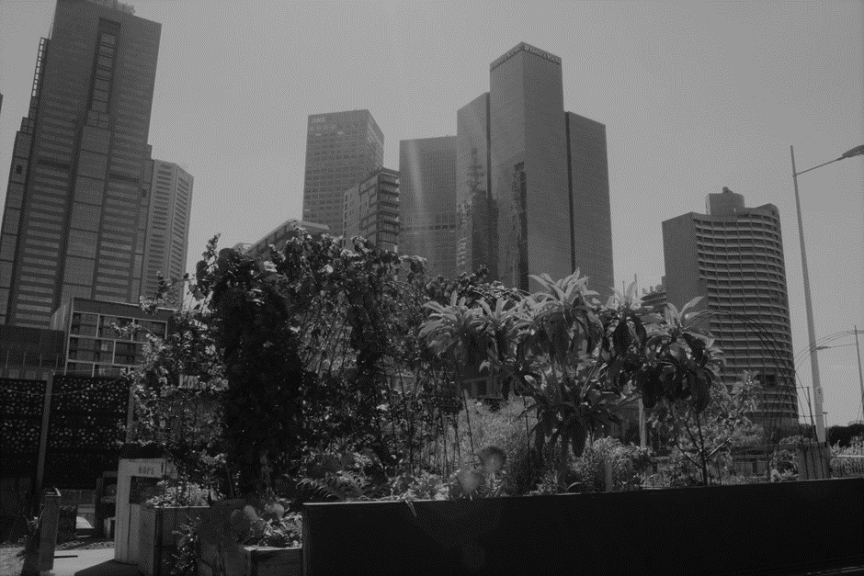
Food Security
Need to create more innovative food production locations such on city roof tops buildings rather than de-forest the land
Melbourne, Australia

Slide 18
Food Security
In terms of tourism, food wastage is a major concern. Questions that should be asked:
Should restaurants reduce the number of food buffets in an attempt to reduce food wastage?
Should restaurants supply more nutritious foods?
Should nutritious food only be available to those who can afford it?
Other considerations:
customer expectations, supplier adaptations, public health information and government intervention

Slide 19
Summary
Although tourism experiences will change depending on circumstance, it does not mean tourism will fail or even decline.
The tourism industry needs to adapt to the changing conditions and ideally take into consideration the overall economic, environmental, technological, cultural, political and nutritional concerns to offer tourism experiences to the benefit of all.

Slide 20
Case Study
Case Study: View the clip
https://www.youtube.com/watch?v=VCYeLuURxRM
Discussion Questions
The video clip suggests that there is currently enough food to feed at least 11 billion people: however, an inadequacy in food distribution is the main issue.
a) Should paying tourists receive better quality and nutritional food than a person from a lower socio-economic background?
b) Should paying tourists receive food in abundance, such as eating from buffets?
How can the tourism, hospitality and event sectors actively change to
reduce food wastage and perhaps re-direct nutritional food options to
people born into poverty?

Slide 21
Additional Resources
Apeel Fruit and Vegetables: https://apeelsciences.com/our-story
Chep Food Reduction and Wastage: https://www.chep.com/zw/en/consumer-goods/solutions/corporate-social-responsibility/food-waste-reduction
City Farms: https://popupcity.net/top-5-of-the-greatest-urban-rooftop-farms/
Gross National Happiness: https://www.youtube.com/watch?v=3rNGzD5fWAo
Port August Tomato Farm: https://reneweconomy.com.au/world-first-solar-tower-powered-tomato-farm-opens-port-augusta-41643
Singapore Roof Top Gardens: https://frenzeelo.blogspot.com/2012/05/6-best-rooftop-gardens-to-visit-in.html

